Slide 1
Reo A Channel-Based Model for Component Composition
Seyed Mohammad Mehdi Ahmadpanah
smahmadpanah@aut.ac.ir
Apr. 10, 2018

Slide 2

Outline
Motivation
Introduction
Syntax
Semantics
Tool
Conclusion

Slide 3

Motivation
Modular Design Popularity
Need for a Glue-Language
interfacing gaps must be filled with additional code
Bulk of Specialized Glue-Code in Complex Systems
interfacing code for compositional construction
Maintenance Difficulties
hard to evolve, inflexible
Alternative: construct the glue code compositionally, out of primitive connectors
Reo introduced by Dr. Farhad Arbab in 2004
composition of channels to make complex connectors
Notes:
A channel is a point-to-point medium of communication with its own unique identity and two distinct ends.

Slide 4
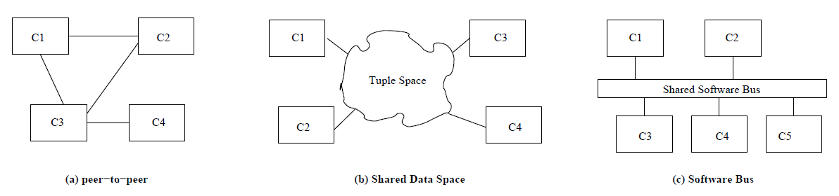
Motivation (cont.)
Channel-based communication models are complete
Advantages over Other Communication Models
Efficiency
Security
Architectural Expressiveness
Anonymity
Notes:
point-to-point

Slide 5
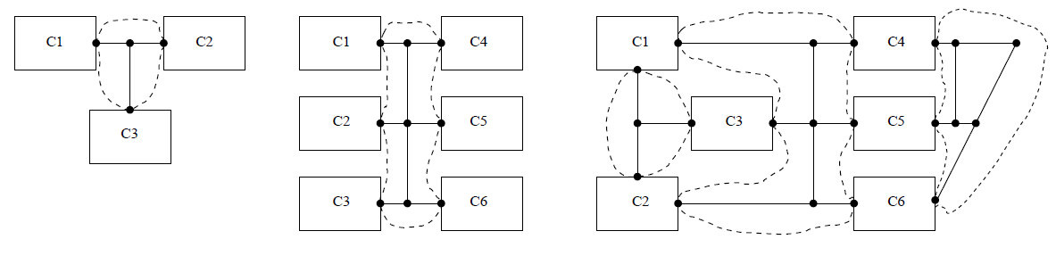
Introduction
System consists of Components and Connectors
Emphasis on Connectors and their composition only!
Coordination from outside
Based on calculus of channels
complex connectors are constructed through composition of simpler ones
the simplest connectors being an arbitrary set of channels with well-defined behavior
Notes:
A channel represents a primitive interaction.

Slide 6
Channel Types
Sync (write/take)
Lossy
SyncDrain (write/write)
FIFO and FIFOn

Slide 7
Node Types
Source: accepts data into its channel
Sink: dispenses data out of its channel
Mixed: Source + Sink (no buffer)
Notes:
channels have exactly two directed ends: source/sink

Slide 8
Syntax
The set of primitive operations on channels and channel ends
create(ChanType)
forget(e)
move(e, loc)
connect([t,] e)
disconnect(e)
wait([t,] conds)
read([t,] inp[, v[, pat]])
take([t,] inp[, v[, pat]])
write([t,], outp, v)
join(e1, e2)
split(e[, quoin])
hide(e)

Slide 9
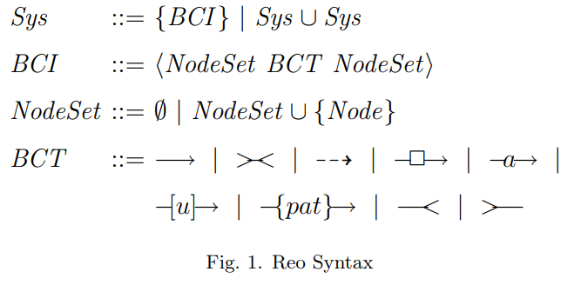
Syntax (cont.)

Slide 10
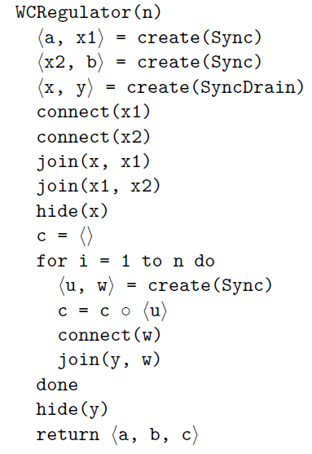
Channel Composition
Write-Cue Regulator
Barrier Synchronization

Slide 11
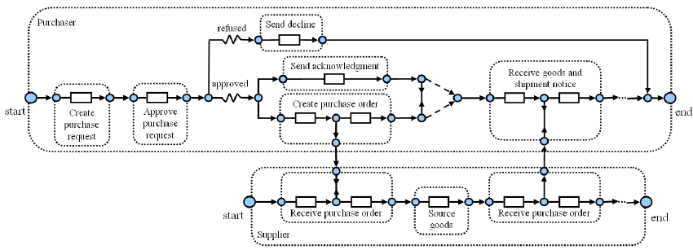
Real World Example
Reo Circuit for the Purchase Order Scenario

Slide 12
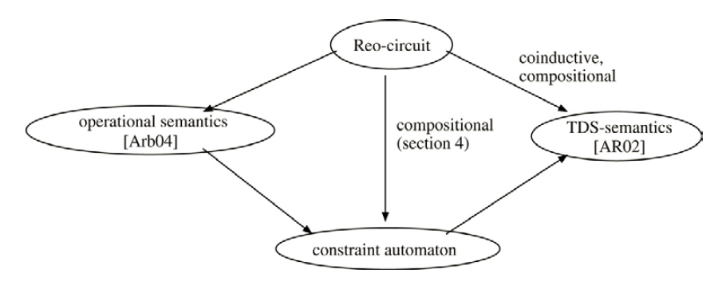
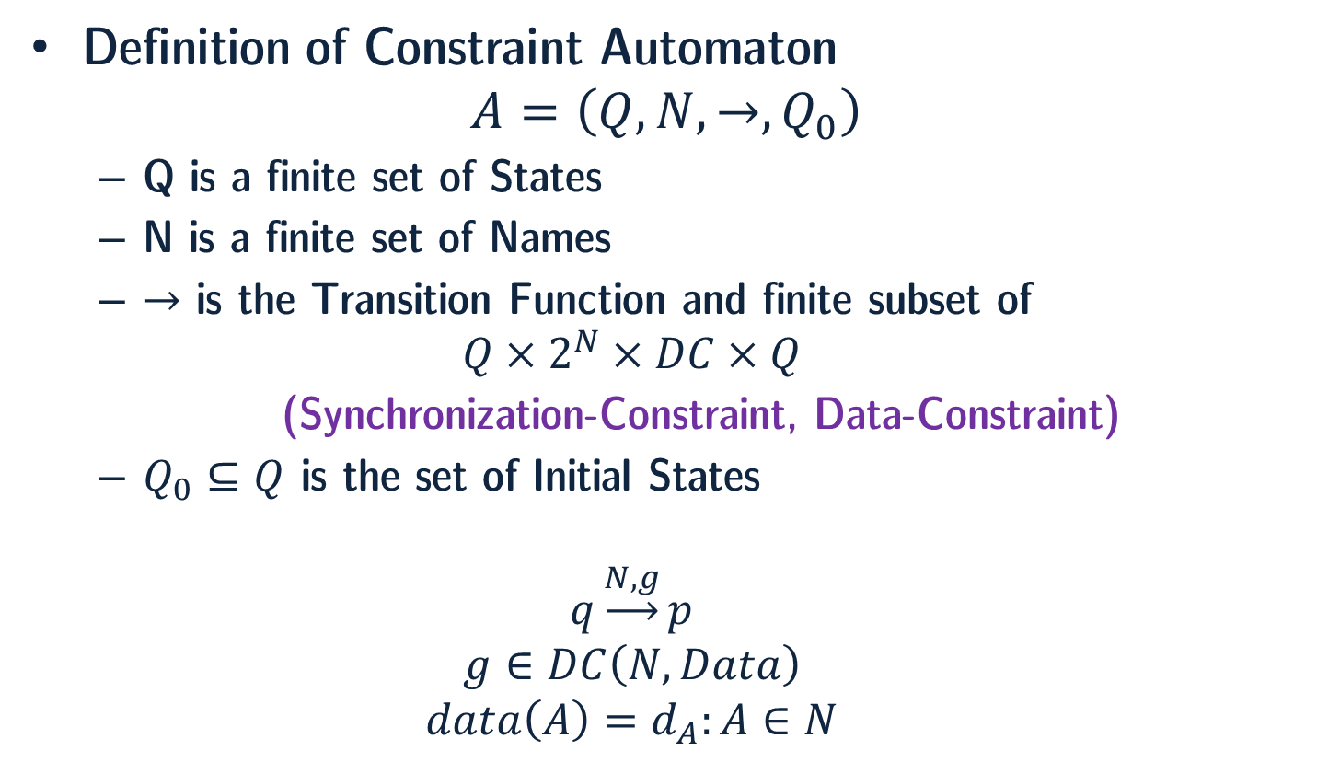
Semantics
Definition of Constraint Automaton
$$A=\left(Q, N, →, Q_{0}\right)$$
Q is a finite set of States
N is a finite set of Names
$→$ is the Transition Function and finite subset of
$$Q×2^{N}×DC×Q$$
(Synchronization-Constraint, Data-Constraint)
$Q_{0}⊆Q$ is the set of Initial States
$$q\underset{→}{N,g}p$$
$$g∈DC\left(N, Data\right)$$
$$data\left(A\right)=d_{A}:A∈N$$
Notes:
Formal semantics:
Coalgebraic semantics based on timed-data streams.
Constraint automata.
SOS semantics (in Maude).
Constraint propagation (connector coloring scheme).
Intuitionistic linear logic
Finite-state automata where a transition has a pair of constraints as its label:
(Synchronization-constraint, Data-constraint)
Introduced to capture operational semantics of Reo

Slide 13
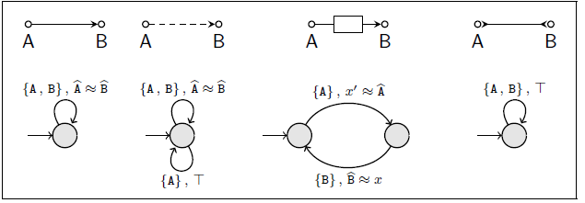
Semantics (cont.)
Constraint Automata Examples
Synchronous
Lossy Synchronous
Asynchronous FIFO
Synchronous Drain

Slide 14
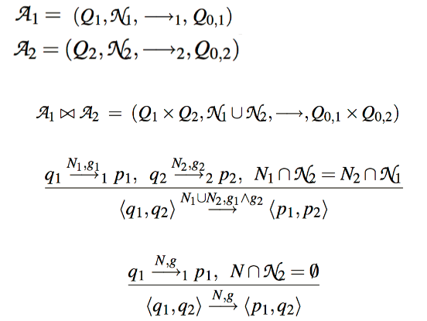
Semantics (cont.)
Product Automata (Join)

Slide 15
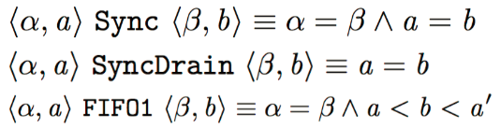
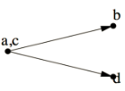
Semantics (cont.)
Relation on Timed Data Streams (TDS)
Examples
Channels
Replicator

Slide 16
Tool
Extensible Coordination Tools (ECT)
set of Eclipse Plugins
Graphical Editing of Reo connectors and constraint automata
Animation of Reo connectors
Code Generation from Reo connectors or constraint automata
Model Checking connectors using Vereofy and mCRL2

Slide 17
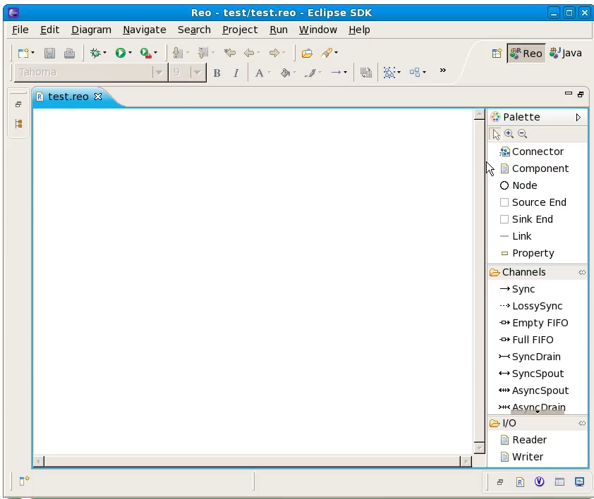
Tool

Slide 18

Conclusion
Reo is a language for compositional construction of interaction protocols
Interaction is the only first-class concept in Reo
Protocols manifest as a connectors
In its graphical syntax, connectors are graphs
Data items flow through channels represented as edges
Boundary nodes permit (components to perform) I/O operations
Formal semantics given as Constraint Automata (and various other formalisms)
Tool support: draw, animate, verify, compile

Slide 19
Comparison
Conventional
action based
process as primitive
imperative
functional
imperative programming
protocol implicit in processes
Reo
interaction based
protocol as primitive
declarative
relational
constraint programming
tangible explicit protocols
Reo is more expressive than Petri nets, workflow, dataflow, Kahn networks, synchronous languages, and stream processing languages.

Slide 20
References
[1] F. Arbab “Reo: A Channel-Based Coordination Model for Component Composition,” Mathematical Structures in Computer Science, vol 14(03), pp. 329-366, 2004.
[2] C. Baier, M. Sirjani, F. Arbab, and J. Rutten “Modeling Component Connectors in Reo by Constraint Automata,” Science of Computer Programming, vol 61(2), pp. 75-113, 2006.
[3] N. Kokash, and F. Arbab, “Formal Behavioal Modeling and Compliance Analysis for Service-Oriented Systems,” Formal Methods for Components and Objects, pp. 21-41, 2008.
[4] M. R. Mousavi, M. Sirjani, and F. Arbab, “Formal Semantics and Analysis of Component Connectors in Reo,” Electronic Notes in Theoretical Computer Science, vol. 154, pp. 83–99, 2006.
[5] Reo homepage, http://reo.project.cwi.nl/reo/
Animations from http://reo.project.cwi.nl/webreo/

Slide 21

Any Questions?

